Slide 1

Phase Vocoder Effects
Mutation, Robotisaton, Whisperisation, Pitch shifting, Time scaling

Slide 2
Phase Vocoder
Sound analysis-synthesis techniques performed in the spectral domain
widely recognised ‘standard’ implementation
decompose signal over short windowed frames (STFT) to analyse frequency content over time
Take into account phase information
Applications
Time scaling / pitch shifting of audio
Signal Content Analysis
Denoising
Sound synthesis by example
Pitch detection
Steady State/Transient Separation
…

Slide 3

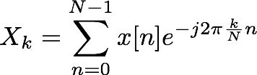
Introduction: FFT
What is the FFT?
Fast Fourier Transform
Algorithm to compute Discrete Fourier Transform (DFT) for evenly-spaced frequency samples
DFT can be seen as sampling of Discrete-Time Fourier Transform (DTFT)
DTFT:
DFT:
FFT:
(continuous frequency)
(discrete frequency)
Same as DFT: just a specific implementation

Slide 4
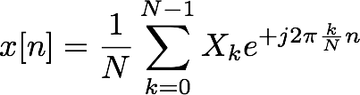
Introduction: FFT
Reconstructing signal from DFT/FFT
Inverse Discrete Fourier Transform (IDFT/IFFT)
DFT:
IDFT:
Notice: N time samples N frequency samples
Two different perspectives on same signal
Given a signal of length M, can exactly reconstruct from an FFT of length N ≥ M
What happens with an FFT of length N < M?
Aliasing

Slide 5
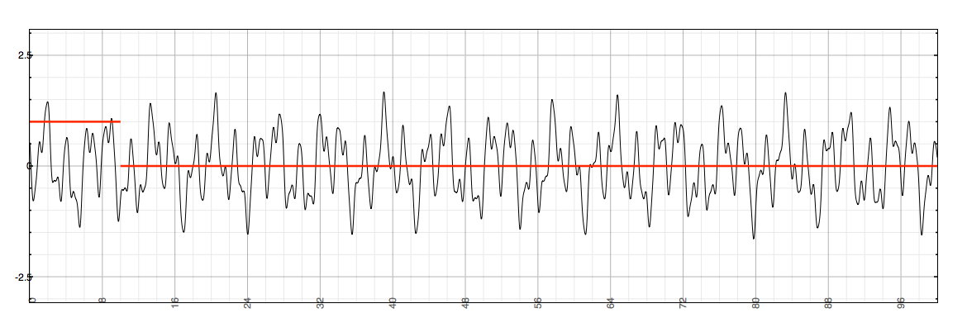
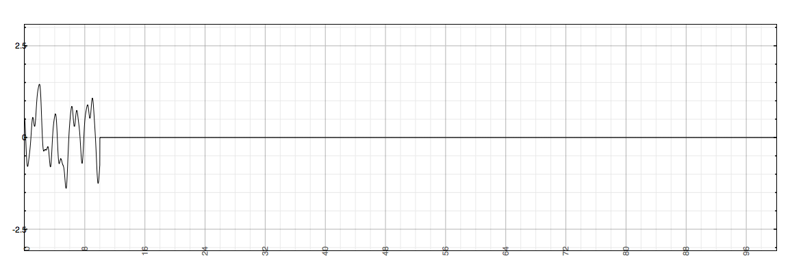
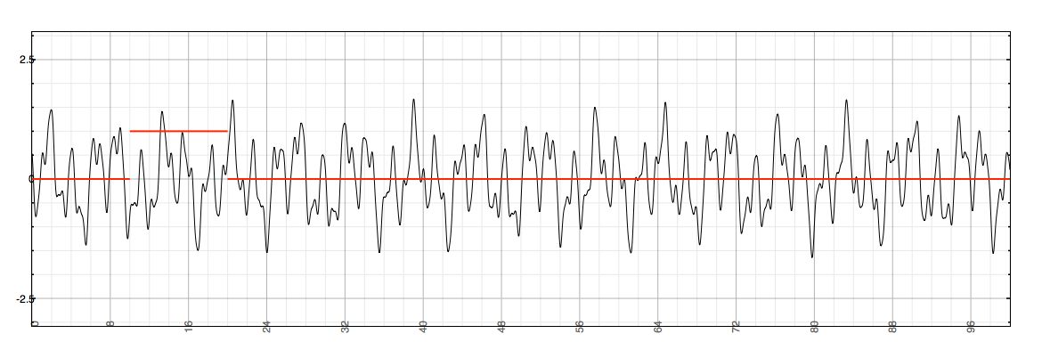
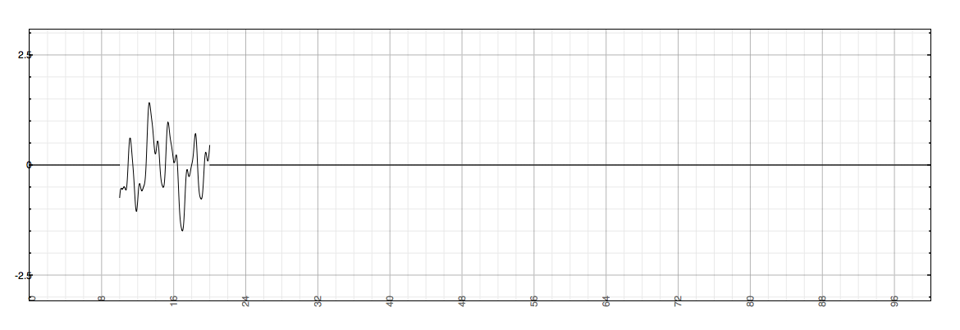
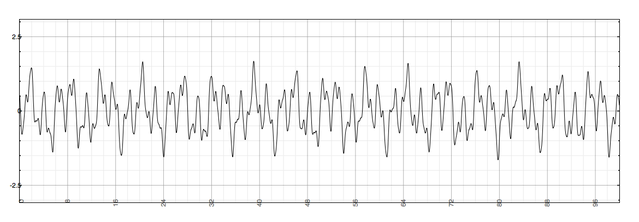
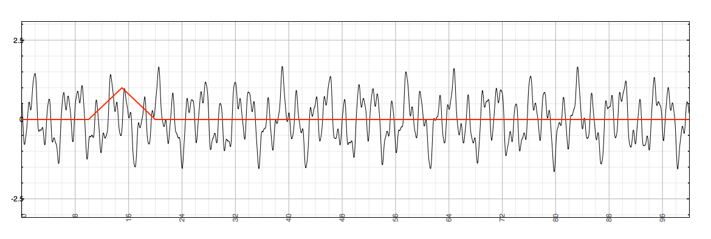
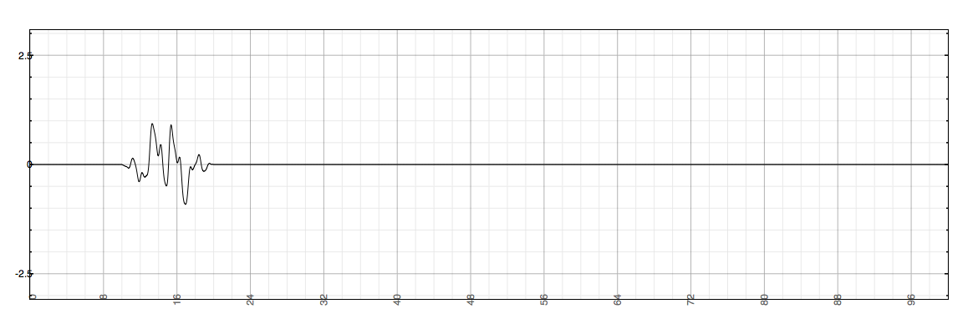
Windowing
Suppose we look at only short slice of input signal
Want instantaneous snapshot of frequency content
Window the signal, then apply the DFT
Multiply by a function that’s nonzero for a fixed length M
Might also have a shape within the nonzero section: rectangular, triangular (Bartlett), Hamming, Blackman, etc.
Can reconstruct windowed signal from DFT length N as long as N ≥ M

Slide 6
Four popular window functions

Slide 7
Effect of a rectangular window and a Hann window applied to a signal

Slide 8

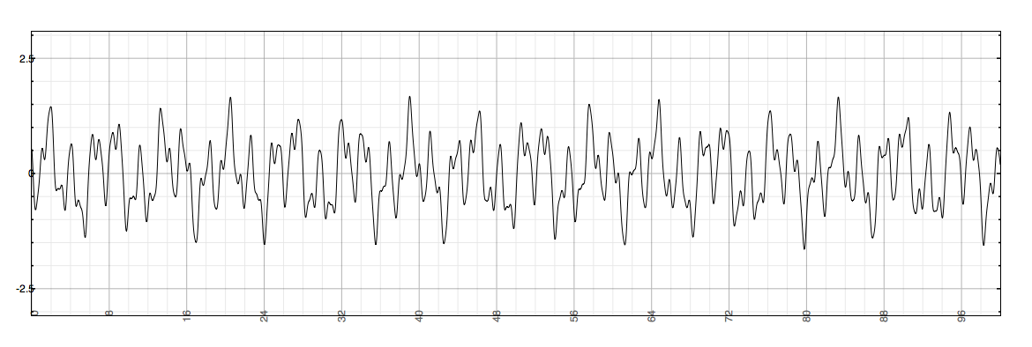
Short-Time Fourier Transform
Short-Time Fourier Transform (STFT) is the DTFT of the windowed signal
Similarly, can take DFT/FFT for discrete samples of windowed signals
Can break any signal into windowed segments
...then (in the right circumstances) put it back together

Slide 9
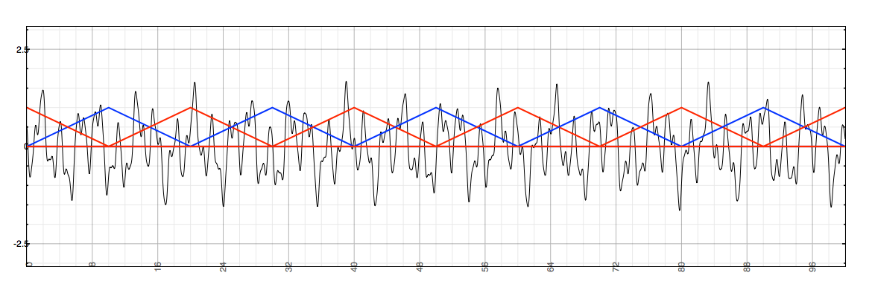
Overlap-Add
Can split signal into overlapping segments
Distance between segments is called hop size
Here, reconstruction from triangular windows with hop size M/2 (can do same with Hamming windows)
Remember, take DFT of each segment to get frequency content, IDFT to get back...

Slide 10
Overlap-Add
Overlap-Add processing method:
Take m^{th} segment (frame) of length M using windowing function
Take DFT of length N ≥ M of segment
If N > M, zero-pad the segment (add zeros to end)
Do something interesting to frequency data
Take IDFT to get back to time domain segment
Add result to output buffer containing prior segments
Advance by hop size to (m+1)^{th} frame and repeat

Slide 11
Overview of Overlap and Add Process
x[n]
...
Segment audio by applying window function
Apply FFT to each segment
Extract phases and amplitudes
Do stuff!
Apply IFFT to each segment
Overlap segments and append on to output audio
Break input signal into windows
...
Hop Size
FFT
Window Size
for each window:
Frequency Domain
Processing
IFFT
...
Add results of each IFFT to output
+
+
+
+
+
+
...
y[n]

Slide 12
Relationship between actual phase and target phase.
Instantaneous frequency represented by gradient of dashed line
Bin frequency is gradient of solid line.
Φ_{t} – target phase
Φ_{d} –phase deviation
φ
Phase
φ_{d}
φ_{t}
ω_{k}h
k-1
Frequency bin
k

Slide 13
constant overlap-add criterion requires that window functions, when overlapped, add to constant value. holds in top plot, but not bottom plot.

Slide 14
complex baseband filterbank implementation (top) where h[n] is low pass filter, and complex bandpass implementation (bottom). Only filters for first 3 bins shown
e^{-jω n}
e^{jω n}
0
0
h[n]
X[n,ω₀]
e^{-jω n}
e^{jω n}
1
1
x[n]
h[n]
X[n,ω₁]
y[n]
e^{-jω n}
e^{jω n}
2
2
h[n]
X[n,ω₂]
.
.
.
.
.
.
e^{-jω n}
e^{jω n}
0
0
h[n]e^{jω0n}
X[n,ω₀]
e^{-jω n}
e^{jω n}
1
1
x[n]
h[n]e^{jω1n}
X[n,ω₁]
y[n]
e^{-jω n}
e^{jω n}
2
2
h[n]e^{jω2n}
X[n,ω₂]
.
.
.
.
.
.

Slide 15
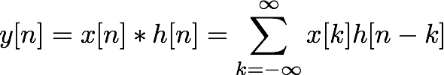

Applications
Many possibilities between DFT and IDFT
Efficient FIR convolution
FIR filter of length N needs N multiplies per sample
Convolution in time = multiplication in frequency
Mutation and cross-synthesis
Robotisation and whisperisation
Time-stretching and pitch-shifting
X(z)
H(z)
Y(z)

Slide 16



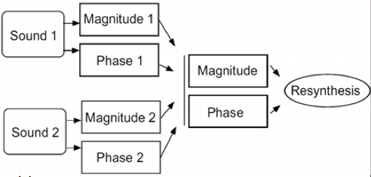
Mutation
DFT bins have magnitude and phase
Suppose we have DFTs of two signals
Combine magnitudes and phases in interesting combinations
Sometimes known as cross-synthesis or morphing
For example, magnitude from one, phase from other

Slide 17
Mutation
Example operations on magnitude only
Multiplication: r = r1 * r2
Multiplication in linear terms = addition in dB scale
Similar to spectral AND operation, keeping zones where energy is located in both signals
For fixed r2 (and zero phase z2), equivalent to FIR filtering
Addition: r = r1 + r2
Similar to spectral OR operation
Not simple mixing: only operating on magnitudes, not phases
Masking: r = (r2 > threshold ? r1 : 0)
Keep magnitude of one sound only if the other is above a threshold
(A ? B : C) syntax means “if A, then B, otherwise C”

Slide 18
Mutation
Phase is critical to time-frequency representations
Explains how signals evolve from frame to frame
Has an important influence on output quality
Example operations on phase of two inputs
Keep phase of only one sound, change magnitude
Phase is a strong cue for pitch of sound (why?)
Result: pitch influenced by the phase you keep
Add phases
Strong alteration: phase moves at double speed on average
Or double the reconstruction hop size: n2 = 2 * n1
Arbitrary combination or variation on phases

Slide 19

Robotisation
Robotisation = applying fixed pitch onto a sound
Implemented by setting DFT phase values to 0 before reconstruction
Forces periodicity: erratic and random variations converted into fixed-pitch sound
Pitch determined by hop size between segments
Can even be adjusted dynamically to create pitch changes
“Robot voice” effect
Sound examples: before and after robotisation

Slide 20
Robotisation VST I
int inwritepos; // Write pointer into the input buffer
int outwritepos; // Write pointer into the output (overlap-add) buffer
int outreadpos; // Read pointer into the output buffer
int inputBufferLength; // Length of the input buffer (in samples)
int outputBufferLength; // Length of the output buffer (in samples)
int sampsincefft; // Counter of how many samples have elapsed since last FFT
float *windowBuffer; // Buffer that holds the (pre-calculated) window function
int windowBufferLength; // Length of the window function
float *fftTimeDomain; // Buffer that holds time-domain samples for the FFT calculation
float *fftFrequencyDomain; // Buffer that holds frequency-domain samples from FFT
float fftScaleFactor; // Scaling factor to normalize output level; depends on window/hop sizes
int fftTransformSize_; // Size of the FFT calculation (in samples); normally equals
// window size but could be longer
int hopSize_; // Hop size parameter (in samples)
// Collect the audio samples in the input buffer. When we've reached the next
// hop interval, calculate the FFT and process the pitch shift.

Slide 21
Robotisation VST II
for (int i = 0; i < numSamples; ++i)
{
const float in = channelData[i];
// Store the next buffered sample in the output. Do this first before anything
// changes the output buffer-- we will have at least one FFT size worth of data
// stored and ready to go. Set the result to 0 when finished in preparation for the
// next overlap/add procedure.
channelData[i] = outputBufferData[outreadpos];
outputBufferData[outreadpos] = 0.0;
if(++outreadpos >= outputBufferLength) outreadpos = 0;
// Store the current sample in the input buffer, incrementing the write pointer. Also
// increment how many samples we've stored since the last transform. If it reaches
// the hop size, perform an FFT and any frequency-domain processing.
inputBufferData[inwritepos] = in;
if (++inwritepos >= inputBufferLength) inwritepos = 0;

Slide 22
Robotisation VST III
if (++sampsincefft >= hopSize_)
{
sampsincefft = 0;
// Find the index of the starting sample in the buffer. When the buffer length
// is equal to the transform size, this will be the current write position but
// this code is more general for larger buffers.
int inputBufferStartPosition = (inwritepos + inputBufferLength
- fftTransformSize_) % inputBufferLength;
// Window the buffer and copy it into the FFT input
int inputBufferIndex = inputBufferStartPosition;
for(int fftBufferIndex = 0; fftBufferIndex < fftTransformSize_; fftBufferIndex++)
{
// Set real part to windowed signal; imaginary part to 0.
fftTimeDomain[fftBufferIndex][1] = 0.0;
if(fftBufferIndex >= windowBufferLength) // Safety check, in case window
// isn't ready
fftTimeDomain[fftBufferIndex][0] = 0.0;
else
fftTimeDomain[fftBufferIndex][0] = windowBuffer[fftBufferIndex]
* inputBufferData[inputBufferIndex];
inputBufferIndex++;
if(inputBufferIndex >= inputBufferLength)
inputBufferIndex = 0;
}

Slide 23
Robotisation VST IV
// Perform the FFT on the windowed data, going into the frequency domain.
// Result will be in fftFrequencyDomain
fftw_execute(fftForwardPlan_);
// ********** PHASE VOCODER PROCESSING GOES HERE **************
// This is the place where frequency-domain calculations are made
// on the transformed signal. Put the result back into fftFrequencyDomain
// before transforming back.
// ************************************************************
for(int bin = 0; bin < fftTransformSize_; bin++)
{
float amplitude = sqrt(fftFrequencyDomain[bin][0]*fftFrequencyDomain[bin][0]
+ fftFrequencyDomain[bin][1]*fftFrequencyDomain[bin][1]);
// Set the phase of each bin to 0. phase = 0 means the signal is entirely
// positive-real, but the overall amplitude is the same as before.
fftFrequencyDomain[bin][0] = amplitude;
fftFrequencyDomain[bin][1] = 0.0;
}
// Perform the inverse FFT to get back to the time domain. Result wll be
// in fftTimeDomain. If we've done it right (kept the frequency domain
// symmetric), the time domain resuld should be strictly real allowing us
// to ignore the imaginary part.
fftw_execute(fftBackwardPlan_);

Slide 24
Robotisation VST V
// Add result to output buffer, starting at current write position
// (Output buffer will have been zeroed after reading the last time around)
// Output needs to be scaled by the transform size to get back to original
// amplitude: this is a property of how fftw is implemented. Scaling will also
// need to be adjusted based on hop size to get the same output level (smaller
// hop size produces more overlap and hence higher signal level)
int outputBufferIndex = outwritepos;
for(int fftBufferIndex = 0; fftBufferIndex < fftTransformSize_; fftBufferIndex++)
{
outputBufferData[outputBufferIndex] += fftTimeDomain[fftBufferIndex][0] * fftScaleFactor;
if(++outputBufferIndex >= outputBufferLength) outputBufferIndex = 0;
}
// Advance the write position within the buffer by the hop size
outwritepos = (outwritepos + hopSize_) % outputBufferLength;
}
}

Slide 25
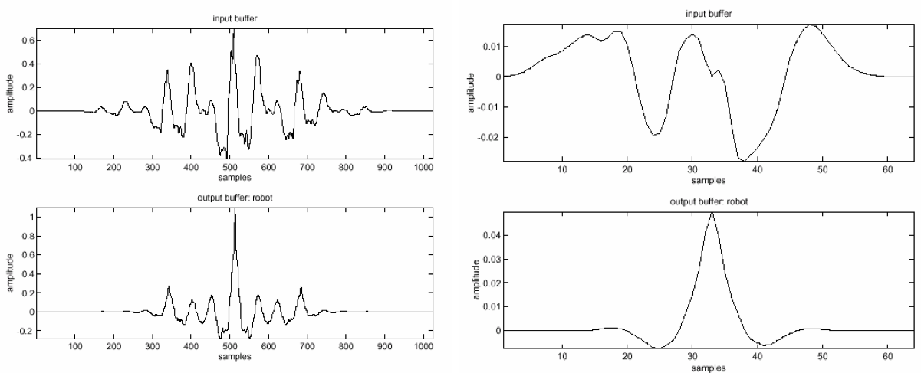
Robotisation
Window size affects performance
Use short window to capture just one period of waveform per segment
Left: M = 1024; Right: M = 64

Slide 26
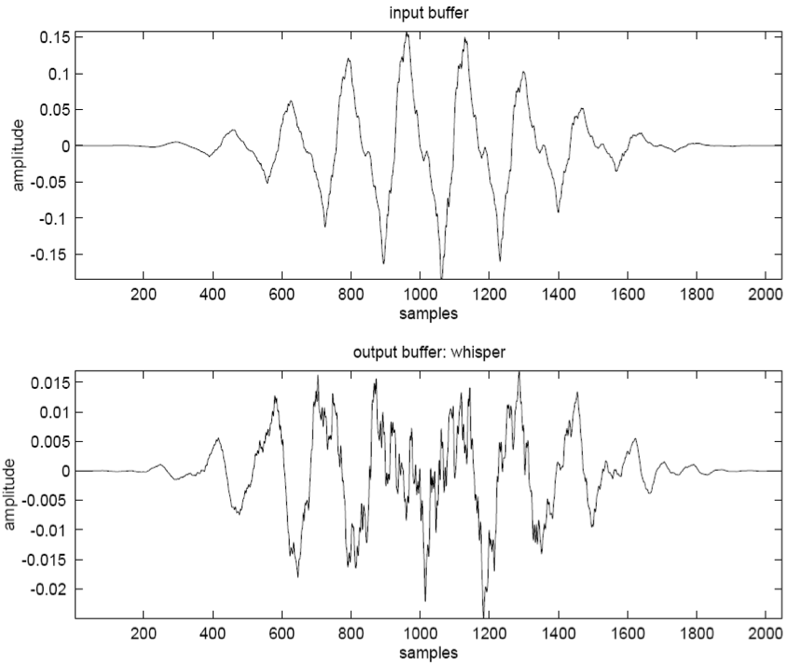
Whisperisation
Whisperisation = erasing pitch cues
Implemented by randomising DFT phases before reconstruction
Short window lengths work best

Slide 27
Whisperisation VST
adapt previous robotization code example to perform whisperization
basic overlap-add structure stays
only need to change lines following FFT calculation
int for(int bin = 0; bin <= fftTransformSize_ / 2; bin++)
{
float amplitude = sqrt(fftFrequencyDomain[bin][0]*fftFrequencyDomain[bin][0] +
fftFrequencyDomain[bin][1]*fftFrequencyDomain[bin][1]);
// This is what we would use to exactly reconstruct the signal:
// float phase = atan2(fftFrequencyDomain[bin][1], fftFrequencyDomain[bin][0]);
// Instead, use this to scramble phase:
float phase = 2.0 * M_PI * (float)rand() / (float)RAND_MAX;
// Set phase of each bin to 0. phase = 0 means signal entirely positive-real,
// but overall amplitude same as before.
fftFrequencyDomain[bin][0] = amplitude * cos(phase);
fftFrequencyDomain[bin][1] = amplitude * sin(phase);
// FFTs of real signals are conjugate-symmetric. We need to maintain that symmetry
// to produce a real output, even as we randomize the phase.
if(bin > 0 && bin < fftTransformSize_ / 2) {
fftFrequencyDomain[fftTransformSize_ - bin][0] = amplitude * cos(phase);
fftFrequencyDomain[fftTransformSize_ - bin][1] = -amplitude * sin(phase);
}
}

Slide 28
Denoising
Removal of unwanted low level sounds not intended to be in signal
Reduce unwanted low level sound on musical recording usually 'hiss' or 'hums'
Remove artefacts produced by nonlinear operations
Minimize unwanted low level (generally high) frequencies
Noise from any number of sources
usually appears as high frequency 'hiss', or low level 'hum'
Goals
achieve clean crisp signal by reducing overall noise
Don’t disrupt wanted signal
Denoising performed using analysis and synthesis
extract magnitude and phase information
Phase unchanged
Low magnitudes attenuated

Slide 29


Denoising
Two basic nonlinear algorithms:
and
x is input signal, c is noise reduction coefficient
Another example implementation:
Similar to applying noise gate
However, operates on each frequency component
Only magnitude modified; phase remains as it was
function ft = denoise(f,r,coef)
if abs(f) >= 0.001
ft = f.*(r./(r+coef));
else
ft = f.*(r./(r+sqrt(coef)));
end

Slide 30
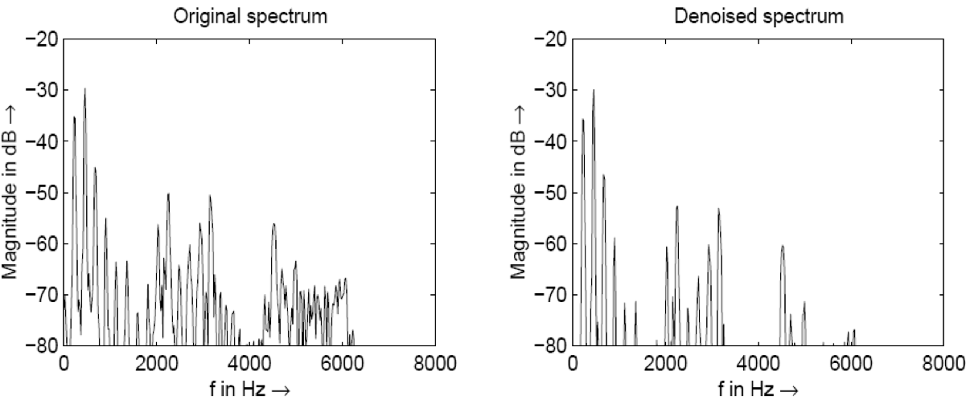
Denoising
Example spectra for windowed FFT of flute sound
Left: input signal
Right: output according to with c = 0.01

Slide 31
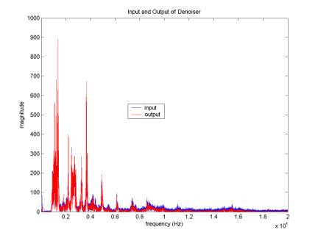
Denoising example
Denoising reduces amplitudes of each bin
Need to boost overall signal level to maintain loudness
Similar to dynamic range compressor
In this example, gain of 4.75 to restore level

Slide 32
Denoising variations
Analyse noise content first
Apply different nonlinear function to each bin
For example, reducing ventilation noise in a room
Time-varying noise estimation
Estimate noise threshold as function of spectrum
Often involves LPC or cepstral techniques
Use noise estimation to decrease pumping effects
Denoising is nonlinear and can produce artefacts
Small grains (spurious components) that jump out
Noise can also be a useful component of a sound

Slide 33
Time scaling and pitch shifting
Analysis identical to any standard phase vocoder
Synthesis hop size varied for time compression/expansion
Changes time scale without changing pitch
If pitch shifting, interpolate back to original time scale
Now pitch changed, but time scale is unchanged

Slide 34
Pitch shifting VST I
int outwritepos; // Temporary write pointer
float *inputBufferData; // Buffered input samples awaiting FFT
int inputBufferLength; // Length of the input buffer (in samples)
float *outputBufferData; // Buffered output samples for overlap-add
int outputBufferLength; // Length of the output buffer (in samples)
int sampsincefft; // Counter of how many samples have elapsed since last FFT
float *windowBuffer; // Buffer that holds the analysis window function
int windowBufferLength; // Length of the analysis window function
float *synthWindowBuffer; // Buffer that holds the synthesis window function
int synthesisWindowLength;// Length of the synthesis window
float *fftTimeDomain; // Buffer that holds time-domain samples for the FFT calculation
float *fftFrequencyDomain; // Buffer that holds frequency-domain samples from FFT
float fftScaleFactor; // Scaling factor to normalize output level; depends on window/hop sizes
float *resampledOutput; // Buffer holding resampled (interpolated) output from FFT
float **lastPhase; // Previous phase values for each bin and channel
float **psi; // Adjusted phase values for each bin and channel
int fftTransformSize_; // Size of the FFT calculation (in samples); normally equals
// window size but could be longer
double pitchRatio_; // Ratio of output to input frequency
int analysisHopSize_; // Hop size parameter for input (in samples)
int synthesisHopSize_; // Hop size parameter for output (in samples)
// synthesis / analysis size should match pitchRatio_

Slide 35
Pitch shifting VST II
executes the pitch shift for one (overlapped) FFT window
fftw_execute(fftForwardPlan_);
for (int i = 0; i < fftTransformSize_; i++) {
// Convert bin into magnitude-phase representation
double magnitude = sqrt(fftFrequencyDomain[i][0] * fftFrequencyDomain[i][0] +fftFrequencyDomain[i][1] * fftFrequencyDomain[i][1]);
double phase = atan2(fftFrequencyDomain[i][1], fftFrequencyDomain[i][0]);
// Calculate frequency for this bin
double frequency = 2.0 * M_PI * (double)i / fftTransformSize_;
// Increment the phase based on frequency and hop sizes
double deltaPhi = (frequency * analysisHopSize_) +
princArg(phase - lastPhase[i][channel] - (frequency * analysisHopSize_));
lastPhase[i][channel] = phase;
psi[i][channel] = princArg(psi[i][channel] + deltaPhi * synthesisHopSize_);
// Convert back to real-imaginary form
fftFrequencyDomain[i][0] = magnitude * cos(psi[i][channel]);
fftFrequencyDomain[i][1] = magnitude * sin(psi[i][channel]);
}
fftw_execute(fftBackwardPlan_); // Perform inverse FFT

Slide 36
Pitch Shifting VST III
// Resample output using linear interpolation to stretch it
double outputLength = floor(fftTransformSize_ / pitchRatio_);
for(int i = 0; i < outputLength; i++) {
x = i * fftTransformSize_ / outputLength;
ix = floor(x);
dx = x - (double)ix;
resampleOutput[i] = fftTimeDomain[ix]*(1.0 - dx) + fftTimeDomain[(ix+1)%fftTransformSize_]*dx;
}
// Add the result to the output buffer, starting at the current write position
int outputBufferIndex = outwritepos;
for(int fftBufferIndex = 0; fftBufferIndex < outputLength; fftBufferIndex++) {
if (fftBufferIndex > synthesisWindowLength) outputBufferData[outputBufferIndex] += 0;
else outputBufferData[outputBufferIndex] += resampleOutput[fftBufferIndex] * fftScaleFactor * synthesisWindowBuffer[fftBufferIndex];
if(++outputBufferIndex >= outputBufferLength) outputBufferIndex = 0;
}
// Advance the write position within the buffer by the hop size
// (Use original hop size since we have resampled output back to expected length)
outwritepos = (outwritepos + analysisHopSize_) % outputBufferLength_;

